Slide 1
Apple
Banana

Slide 2
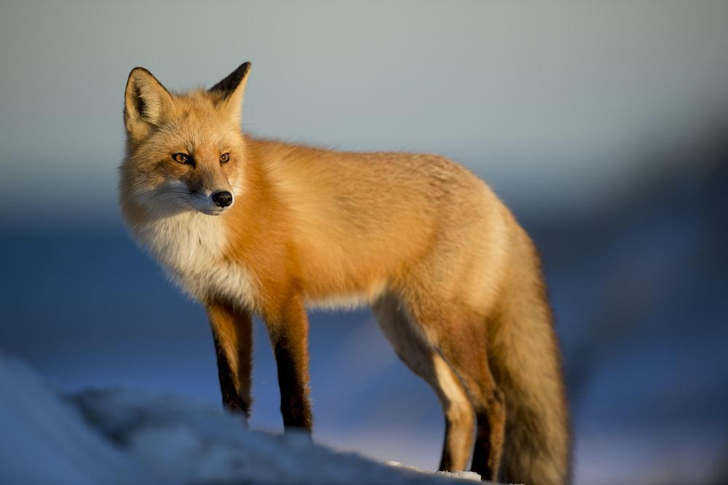
Fox

Slide 3
Modified

